Slide 1
Week9– Leading
第九周-领导

Slide 2
Leadership 领导力
Leader: someone who can influence others and who has managerial authority 管理职权
可以影响他人并拥有管理职权的人
Leadership: a process of influencing a group to achieve goals.
领导力：影响团队实现目标的过程。
Notes:
Study questions
What is the nature of leadership?
What are the important leadership traits and behaviours?
What are the contingency theories of leadership?
What are the current issues in leadership development?

Slide 3
Leadership Theories 领导力理论
Leadership traits
Leadership behaviors
Contingency Theories of leadership
领导特点
领导行为
领导的权变理论

Slide 4
Leadership traits 领导特点
Personal traits common among successful leaders:
  Drive
  Self-confidence
  Creativity
  Cognitive ability
  Business knowledge
  Motivation
  Flexibility
  Honesty & integrity
成功领导者的共同个人特质：
动力
自信
创造力
认知能力
商业知识
动力
灵活性
诚实正直
Notes:
Search for leadership traits
Historically, researchers struggled with their inability to find consistent patterns of leadership traits. More recent research indicates that certain personal traits may be important, but that they must be considered along with other situational factors.
Personal traits common among successful leaders include:
Drive. Successful leaders have high energy, display initiative and are tenacious.
Self-confidence. Successful leaders trust themselves and have confidence in their abilities.
Creativity. Successful leaders are creative and original in their thinking.
Cognitive ability. Successful leaders have the intelligence to integrate and interpret information.
Business knowledge. Successful leaders know their industry and its technical foundations.
Motivation. Successful leaders enjoy influencing others to achieve shared goals.
Flexibility. Successful leaders adapt to fit the needs of followers and the demands of situations.
Honesty and integrity. Successful leaders are trustworthy; they are honest, predictable and dependable.

Slide 5
Leadership behaviours 领导行为
Behavioural theories of leadership sought to determine which leadership style worked best.
Leadership style
  The recurring pattern of behaviours exhibited by a leader.
The two dimensions of leadership style most researched:
  concern for the task to be accomplished/concern for production;
  and concern for the people doing the work/concern for people.
领导行为理论试图确定哪种领导风格最有效。
领导风格
领导者反复表现出的行为模式。
研究最多的领导风格的两个维度：
关注要完成的任务/关注生产;
以及对从事工作的人的关心/对人们的关注。
Notes:
Focus on leadership behaviours
Generally known as behavioural theories of leadership, work in this tradition sought to determine which leadership style — the recurring pattern of behaviours exhibited by a leader — worked best.
If the preferred style could be identified, the implications were straightforward and practical — train leaders to become skilled at using the ideal style to best advantage.
Most research in the leader behaviour tradition focused on two dimensions of leadership style: concern for the task to be accomplished and concern for the people doing the work.
The terminology used to describe these dimensions varies among many studies. Concern for task is sometimes called initiating structure, job-centredness and task orientation; concern for people is sometimes called consideration, employee-centredness and relationship orientation. Regardless of the terminology, the behaviours characteristic of each dimension are quite clear. A leader high in concern for task plans and defines work to be done, assigns task responsibilities, sets clear work standards, urges task completion and monitors performance results. In contrast, a leader high in concern for people acts in a manner that is warm and supportive towards followers, maintains good social relations with them, respects their feelings, is sensitive to their needs and shows trust in them.
The results of leader behaviour research at first suggested that followers of people oriented leaders were more productive and satisfied than those working for more task oriented leaders.
Later results, however, suggested that truly effective leaders were high in both concern for people and concern for task.

Slide 6
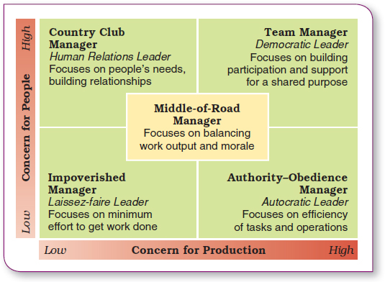
The Managerial Grid– Blake and Mouton 管理网格– 布莱克和木桐
关心人（高） | 乡村俱乐部管理者 人际关系型领导者 专注于人们的需求，建立关系 | 团队管理者 民主型领导者 专注于为共同目标建立参与度和支持
关心人（低） | 放任型管理者 自由放任型领导者 专注于以最少的努力完成工作 | 权威 - 服从管理者 专制型领导者 专注于任务和运营的效率
中庸型管理者 专注于平衡工作产出和士气 | 关心生产（低） | 关心生产（高）
Notes:
This figure describes one of the popular versions of this conclusion — the Leadership Grid¨ of Robert Blake and Jane Mouton.
This grid is designed not only to describe alternative leadership styles and identify a preferred one, but also to assist in the process of leadership development. The approach uses assessments to first determine where someone falls with respect to people and task concerns. Then a training program is designed to help shift the person’s style in the preferred direction of becoming strong on both dimensions.
Impoverished management displays low concern for both people and tasks. Leaders with this style turn most decisions over to the work group and show little interest in the work process or its results.
Authority-obedience management shows high concern for the task and low concern for people. Leaders with this style make most of the decisions for the work group, give directions and expect their orders to be followed.
Country club management shows high concern for people and low concern for tasks. Leaders with this style are warm in interpersonal relationships, avoid conflict and seek harmony in decision making.
Middle-of-the-road management is non-committal in emphasising both task and people concerns. This leader puts forth minimum required effort in balancing the task and people needs of the group to maintain adequate but not exemplary performance.

Slide 7
The Fiedler Model Fiedler 模型
Fiedler contingency model: a leadership theory proposing that effective group performance depends on the proper match between a leader’s style and the degree to which the situation allows the leader to control and influence.
Fiedler 权变模型：一种领导理论，提出有效的团队绩效取决于领导者的风格与情况允许领导者控制和影响的程度之间的适当匹配
  Least-preferred coworker (LPC) questionnaire:
  a questionnaire that measures whether a leader is task-motivated or relationship-motivated
  最不偏好的同事 （LPC） 问卷：衡量领导者是任务驱动型还是关系驱动型领导的问卷
Fiedler believed that leadership style is part of one's personality and is difficult to change. He suggested that leadership success comes from putting their existing styles to work in situations for which they are the best fit.
Fiedler 认为，领导风格是一个人性格的一部分，很难改变。他建议，领导的成功来自于将他们现有的风格应用于最适合他们的情况下。
Notes:
他认为一个leader的leadership style是不变的
The first comprehensive contingency model for leadership was developed by Fred Fiedler. The Fiedler contingency model proposed that effective group performance depended on properly matching the leader’s style and the amount of control and influence in the situation. The model was based on the premise that a certain leadership style would be most effective in different types of situations. The keys were to (1) define those leadership styles and the different types of situations and then (2) identify the appropriate combinations of style and situation.
Fiedler proposed that a key factor in leadership success was an individual’s basic leadership style, either task oriented or relationship oriented. To measure a leader’s style, Fiedler developed the least-preferred coworker (LPC) questionnaire. This questionnaire contained 18 pairs of contrasting adjectives—for example, pleasant–unpleasant, cold–warm, boring–interesting, or friendly–unfriendly. Respondents were asked to think of all the coworkers they had ever had and to describe that one person they least enjoyed working with by rating him or her on a scale of 1–8 for each of the 18 sets of adjectives (the 8 always described the positive adjective out of the pair and the 1 always described the negative adjective out of the pair).

Slide 8
Fiedler’s Situational Contingency Theory
Fiedler 的情境理论
Leader–member relations: describes the degree of confidence, trust, and respect employees have for their leader
领导者与成员的关系：描述员工对领导者的信心、信任和尊重程度
Task structure: describes the degree to which job assignments are formalized and structured
任务结构：描述工作任务正规化和结构化的程度
Position power: describes the degree of influence a leader has over activities such as hiring, ring, discipline, promotions, and salary increases
职位权力：描述领导者对招聘、环比、纪律、晋升和加薪等活动的影响程度
Notes:
After an individual’s leadership style had been assessed through the LPC, it was time to evaluate the situation in order to be able to match the leader with the situation. Fiedler’s research uncovered three contingency dimensions that defined the key situational factors in leader effectiveness.
• Leader-member relations – the degree of confidence, trust, and respect employees had for their leader; rated as either good or poor.
• Task structure – the degree to which job assignments were formalized and structured; rated as either high or low.
• Position power – the degree of influence a leader had over activities such as hiring, firing, discipline, promotions, and salary increases; rated as either strong or weak.

Slide 9
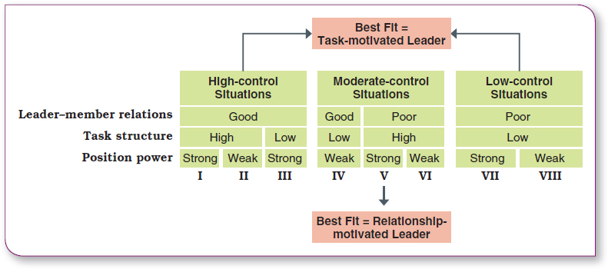
The Fiedler Model Fiedler模型

Slide 10
Hersey and Blanchard’s Situational Leadership Style
Hersey 和 Blanchard 的情境领导风格
Situational leadership theory (SLT): a leadership contingency theory that focuses on followers’ readiness
情境领导理论（SLT）：一种领导权变理论，关注追随者的准备情况
  Readiness: describes the degree to which
  job assignments are formalized and structured
  就绪：说明工作任务正规化和结构化的程度
  The model suggests that successful leaders adjust their styles. They do so wisely and based on the task readiness, or task maturity, of followers. “Readiness” refers to how able and willing or confident followers are to perform required tasks.
  该模型表明，成功的领导者会调整自己的风格。他们会根据追随者的任务准备度或任务成熟度明智地调整自己的风格。所谓 “准备就绪”，是指追随者有多大能力、意愿或信心去完成所要求的任务。
Notes:
Paul Hersey and Ken Blanchard developed a leadership theory that has gained a strong following among management development specialists. This model, called situational leadership theory (SLT), is a contingency theory that focuses on followers’ readiness.
Regardless of what the leader does, the group’s effectiveness depends on the actions of the followers. This important dimension
has been overlooked or underemphasized in most leadership theories. And readiness, as defined by Hersey and Blanchard, refers to the extent to which people have the ability and willingness to accomplish a specific task.

Slide 11
SLT Leadership Styles SLT 领导风格
Telling (high task–low relationship):giving specific task directions and closely supervising work
Selling (high task–high relationship):explaining task directions in a supportive and persuasive way
Participating (low task–high relationship)：emphasizing shared ideas and participative decisions on task directions
Delegating (low task–low relationship)：allowing the group to take responsibility for task decisions
告诉（高任务-低关系）：给出具体的任务指示并密切监督工作
销售（高任务-高关系）：以支持和说服的方式解释任务指示
参与（低任务-高关系）：强调共同想法和参与任务指示的决定
委派（低任务-低关系）：让团队承担任务决策的责任
Notes:
SLT uses the same two leadership dimensions that Fiedler identified: task and relationship behaviors. However, Hersey and Blanchard go a step further by considering each as either high or low and then combining them into four specific leadership styles described as follows:
• Telling (high task–low relationship): The leader defines roles and tells people what, how, when, and where to do various tasks.
• Selling (high task–high relationship): The leader provides both directive and supportive behavior.
• Participating (low task–high relationship): The leader and followers share in decision-making; the main role of the leader is facilitating and communicating.
• Delegating (low task–low relationship): The leader provides little direction or support.

Slide 12
Four Stages of Follower Readiness
追随者任务准备度的四个阶段
R1: both unable and unwilling Telling
R2: unable but willing Selling
R3: able but unwilling Participating
R4: both able and willing Delegating
Notes:
The final component in the model is the four stages of follower readiness:
R1: People are both unable and unwilling to take responsibility for doing something. Followers aren’t competent or confident.
R2: People are unable but willing to do the necessary job tasks. Followers are motivated but lack the appropriate skills.
R3: People are able but unwilling to do what the leader wants. Followers are competent, but don’t want to do something.
R4: People are both able and willing to do what is asked of them.

Slide 13
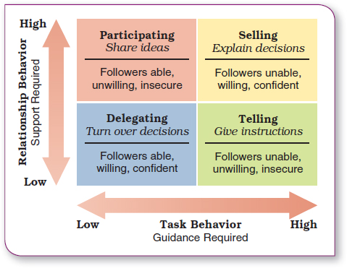




Hersey and Blanchard’s Situational Leadership Theory
Hersey 和 Blanchard 的情境领导理论

Slide 14
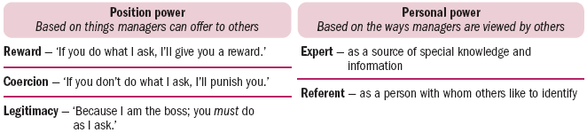
Power and influence
权力和影响
Power 权力
  The ability to get someone else to do something you want done or to make things happen the way you want.
  让别人做你想做的事情或让事情按照你想要的方式发生的能力。
Sources of power:
Notes:
Power and influence
Power is the ability to get someone else to do something you want done. It is the ability to make things happen the way you want them to. Research recognises that a need for power is essential to executive success.
But this need for power is not a desire to control for the sake of personal satisfaction; it is a desire to influence and control others for the good of the group or organisation as a whole. This ‘positive’ face of power is the foundation of effective leadership.

Slide 15
Sources of power - Position power
权力来源-位置权力
The three bases of position power (power that comes from a manager’s official position):
  Reward power is the ability to influence through rewards. ‘If you do what I ask, I’ll give you a reward.’
  Coercive power is the ability to influence through punishment. ‘If you don’t do what I want, I’ll punish you.’
  Legitimate power is the ability to influence through authority. ‘I am the boss and therefore you are supposed to do as I ask.’
位置权力（来自经理的官方地位的权力）的三个基础：
奖励力是通过奖励施加影响的能力。“如果你按照我的要求去做，我就会给你奖励。”
强制力是通过惩罚施加影响的能力。“如果你不按我的意思去做，我就惩罚你。”
合法权力是通过权威施加影响的能力。“我是老大，所以你应该按照我的要求去做。
Notes:
Sources of position power
The three bases of position power are reward power, coercive power and legitimate power.
Reward power is the ability to influence through rewards. It is the capacity to offer something of value — a positive outcome — as a way of influencing the behaviour of other people. This involves the control of rewards or resources such as pay rises, bonuses, promotions, special assignments and verbal or written compliments. To mobilise reward power, a manager says, in effect, ‘If you do what I ask, I’ll give you a reward’.
Coercive power is the ability to influence through punishment. It is the capacity to punish or withhold positive outcomes as a way of influencing the behaviour of other people. A manager may try to coerce someone by threatening him or her with verbal reprimands, pay penalties and even termination. To mobilise coercive power, a manager says, in effect, ‘If you don’t do what I want, I’ll punish you’.
Legitimate power is the ability to influence through authority — the right by virtue of organisational position or status to exercise control over people in subordinate positions. To mobilise legitimate power, a manager says, in effect, ‘I am the boss and therefore you are supposed to do as I ask’.

Slide 16
Sources of power - Personal power权力来源 - 个人权力
Two bases of personal power (power that comes from unique personal qualities):
  Expert power is the ability to influence through special expertise. Other people recognise your knowledge, understanding and skills.
  Referent power is the ability to influence through identification. Other people admire you and want to identify positively with you. Power is derived from charisma or interpersonal attractiveness.
个人力量的两个基础（来自独特个人品质的力量）：
专家能力是通过特殊专业知识进行影响的能力。其他人认可您的知识、理解和技能。
指涉权力是通过认同进行影响的能力。
其他人钦佩你，并希望积极地认同你。权力来自魅力或人际吸引力。
Notes:
Sources of personal power
Another source of power lies in the individual manager and the unique personal qualities that person brings to a leadership situation. Two bases of personal power are expert power and referent power.
Expert power is the ability to influence through special expertise. It is the capacity to influence the behaviour of other people because they recognise your knowledge, understanding and skills. Expertise derives from the possession of technical know-how or information pertinent to the issue at hand. This is developed by acquiring relevant skills or competencies or by gaining a central position in relevant information networks. It is maintained by protecting your credibility and not overstepping the boundaries of true understanding.
Referent power is the ability to influence through identification. It is the capacity to influence the behaviour of other people because they admire you and want to identify positively with you. Reference is a power derived from charisma or interpersonal attractiveness. It is developed and maintained through good interpersonal relations that encourage the admiration and respect of others.

Slide 17
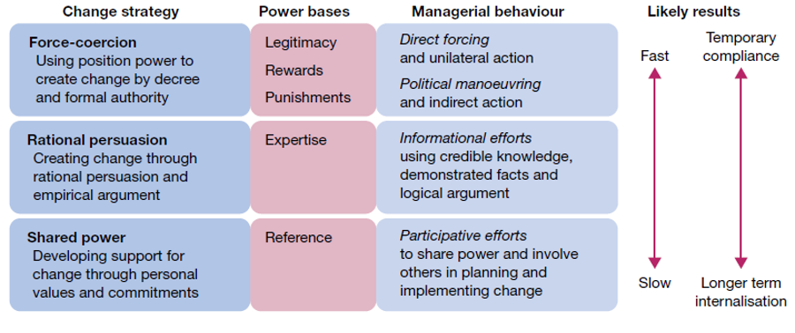
Using power to manage change
利用权力管理变更

Slide 18
变革策略 | 权力基础 | 管理行为 | 可能结果
强制策略 利用职位权力，通过命令和正式权威来推动变革 | 合法性 奖励 惩罚 | 直接强制和单边行动 政治操纵和间接行动 | 快速 | 暂时服从
理性说服策略 通过理性说服和实证论证来推动变革 | 专业知识 | 运用可信的知识、已证实的事实和逻辑论证等信息方面的努力
共享权力策略 通过个人价值观和承诺来获得对变革的支持 | 参照性权力 | 在规划和实施变革中，采取参与式的方式分享权力并让他人参与其中 | 慢速 | 长期内化

Slide 19
Turning power into influence将权力转化为影响力
Relying on rewards, legitimacy, or coercion is likely to lead to only temporary compliance.
Hence, position power alone is often insufficient to achieve and sustain needed influence.
Use of expert and referent power creates the most enduring influence; they create commitment.
Personal power and the bases of expert and referent power often make the difference between leadership success and mediocrity.
依赖奖励、合法性或胁迫可能只会导致暂时的服从。
因此，仅靠位置权力往往不足以实现和维持所需的影响力。
使用专家和参考力量可以产生最持久的影响力;他们创造承诺。
个人权力以及专家和参考权力的基础往往是领导成功与平庸之间的区别。
Notes:
Turning power into influence
When a leader relies on rewards and legitimacy to influence others, the likely outcome is temporary compliance.
When a leader relies on coercion to gain influence, compliance also depends on the continued threat of punishment. In this case, however, the compliance is very temporary and often accompanied by resistance.
Use of expert and referent power creates the most enduring influence; they create commitment. Followers respond positively because of internalised understanding or beliefs that create their own long-lasting effects on behaviour.
Position power alone is often insufficient to achieve and sustain needed influence.
Personal power and the bases of expert and referent power often make the difference between leadership success and mediocrity.

Slide 20
Politics in Organisations
组织中的政治
Politics involve those activities taken within organizations to acquire, develop, and use power and other resources to obtain one’s preferred outcomes in a situation in which there is uncertainty or dissensus about choices.
政治涉及在组织内部进行的那些活动，目的是在选择存在不确定性或分歧的情况下获得、发展和使用权力和其他资源以获得个人喜欢的结果。

Slide 21
Conditions conducive to political behaviour 有利于政治行为的条件
Ambiguous goals
Limited resources
Changing technology and environment
Nonprogrammed decisions
Organizational change
目标模糊
资源有限
不断变化的技术和环境
非程序化决策
组织变革

Slide 22
Limiting political behaviour
限制政治行为
To Reduce System Uncertainty
To Reduce Competition
To Break Existing Political Fiefdoms
To Prevent Future Fiefdoms
减少系统不确定性
减少竞争
打破现有的政治领地
防止未来的封地

